Slide 1
Deadlock and Indefinite Postponement
Outline
7.1 Introduction
7.2 Examples of Deadlock
7.2.1 Traffic Deadlock
7.2.2 Simple Resource Deadlock
7.2.3 Deadlock in Spooling Systems
7.2.4 Example: Dining Philosophers
7.3 Related Problem: Indefinite Postponement
7.4 Resource Concepts
7.5 Four Necessary Conditions for Deadlock
7.6 Deadlock Solutions
7.7 Deadlock Prevention
7.7.1 Denying the “Wait-For” Condition
7.7.2 Denying the “No-Preemption Condition
7.7.3 Denying the “Circular-Wait” Condition

Slide 2
Deadlock and Indefinite Postponement
Outline (continued)
Deadlock Avoidance with Dijkstra’s Banker’s Algorithm
Example of a Safe State
Example of an Unsafe State
Banker’s Algorithm Resource Allocation
Deadlock Detection
Resource-Allocation Graphs
Reduction of Resource-Allocation Graphs
Deadlock Recovery
Deadlock Strategies in Current and Future Systems

Slide 3
Objectives
After reading this chapter, you should understand:
  the problem of deadlock.
  the four necessary conditions for deadlock to exist.
  the problem of indefinite postponement.
  the notions of deadlock prevention, avoidance, detection and recovery.
  algorithms for deadlock avoidance and detection.
  how systems can recover from deadlocks.

Slide 4
Introduction
Definition: A deadlock is a condition that may happen in a system composed of multiple processes that can access shared resources. A deadlock is said to occur when two or more processes are waiting for each other to release a resource. None of the processes can make any progress.
Deadlock is a situation where a set of processes are blocked because each process is holding a resource and waiting for another resource acquired by some other process.
Consider an example when two vehicles are coming toward each other on the same track and there is only one track, none
Deadlock is a situation where a set of processes are blocked because each process is holding a resource and waiting for another resource acquired by some other process.

Slide 5
Cont..
Of the trains can move once they are in front of each other. A similar situation occurs in OS when there are two or more processes that hold some resources and wait for resources held by other(s). For example in the diagram, Process 1 is holding Resource 1 and waiting for resource 2 which is acquired by process 2, and process 2 is waiting for resource 1.

Slide 6
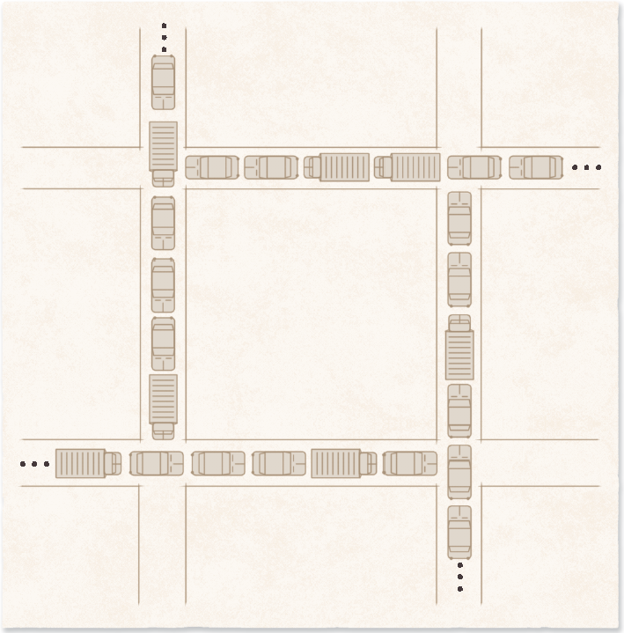
Traffic Deadlock

Slide 7
Cont….
A process in OS uses resources in the following ways:
1. Requests a resource
2. Use the resource
3. Releases a resource

Slide 8
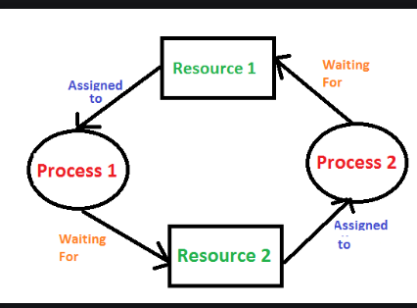
Processes Deadlock
For example in the diagram, Process 1 is holding Resource 1 and waiting or requesting for Resource 2 which is acquired by process 2, and process 2 is waiting for resource 1.

Slide 9
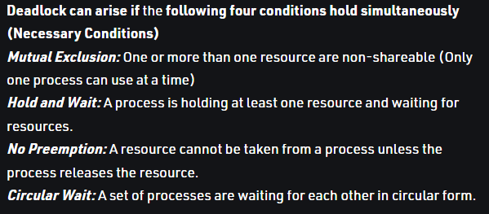
Four Necessary Conditions for Deadlock

Slide 10
Cont…
A mutual exclusion (mutex) is a program object that prevents simultaneous access to a shared resource. This concept is used in concurrent programming with a critical section, a piece of code in which processes or threads access a shared resource.

Slide 11
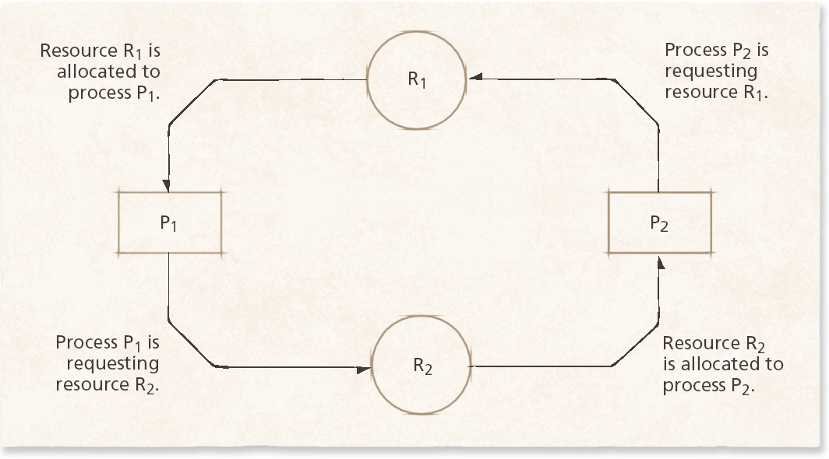
Simple Resource Deadlock
Resource deadlock example. This system is deadlocked because each process holds a resource being requested by the other process and neither process is willing to release the resource it holds.

Slide 12
Related Problem: Indefinite Postponement
Indefinite postponement
  Also called indefinite blocking or starvation
  Occurs due to biases in a system’s resource scheduling policies
Aging
  Technique that prevents indefinite postponement by increasing process’s priority as it waits for resource

Slide 13
Resource Concepts
Preemptible resources (e.g. processors and main memory)
  Can be removed from a process without loss of work
Nonpreemptible resources (e.g. tape drives and optical scanners)
  Cannot be removed from the processes to which they are assigned without loss of work
Reentrant code
  Cannot be changed while in use
  May be shared by several processes simultaneously
Serially reusable code
  May be changed but is reinitialized each time it is used
  May be used by only one process at a time

Slide 14
Deadlock Solutions
Four major areas of interest in deadlock research
  Deadlock prevention
  Deadlock avoidance
  Deadlock detection
  Deadlock recovery

Slide 15
Deadlock Prevention
Deadlock prevention
  Condition a system to remove any possibility of deadlocks occurring
  Deadlock cannot occur if any one of the four necessary conditions is denied
  First condition (mutual exclusion) cannot be broken

Slide 16
Denying the “Wait-For” Condition
When denying the “wait-for condition”
  All of the resources a process needs to complete its task must be requested at once
  This leads to inefficient resource allocation

Slide 17
Denying the “No-Preemption” Condition
When denying the “no-preemption” condition
  Processes may lose work when resources are preempted
  This can lead to substantial overhead as processes must be restarted

Slide 18
Denying the “Circular-Wait” Condition
Denying the “circular-wait” condition:
  Uses a linear ordering of resources to prevent deadlock
  More efficient resource utilization than the other strategies
Drawbacks
  Not as flexible or dynamic as desired
  Requires the programmer to determine the ordering or resources for each system

Slide 19
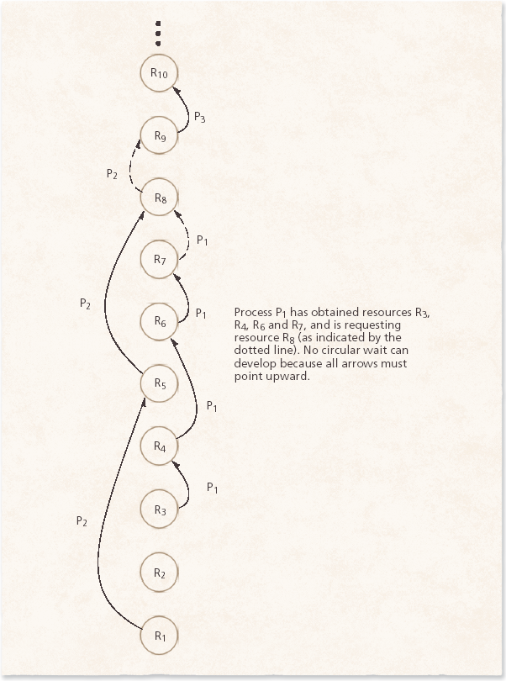
Denying the “Circular-Wait” Condition
Havender’s linear ordering of resources for preventing deadlock.

Slide 20
Deadlock Avoidance with Dijkstra’s Banker’s Algorithm
Banker’s Algorithm
  Impose less stringent conditions than in deadlock prevention in an attempt to get better resource utilization
  Safe state
    Operating system can guarantee that all current processes can complete their work within a finite time
  Unsafe state
    Does not imply that the system is deadlocked, but that the OS cannot guarantee that all current processes can complete their work within a finite time

Slide 21
Deadlock Avoidance with Dijkstra’s Banker’s Algorithm
Banker’s Algorithm (cont.)
  Requires that resources be allocated to processes only when the allocations result in safe states.
  It has a number of weaknesses (such as requiring a fixed number of processes and resources) that prevent it from being implemented in real systems

Slide 22
Deadlock Detection
Deadlock detection
  Used in systems in which deadlocks can occur
  Determines if deadlock has occurred
  Identifies those processes and resources involved in the deadlock
  Deadlock detection algorithms can incur significant runtime overhead

Slide 23
Resource-Allocation Graphs
Resource-allocation graphs
  Squares
    Represent processes
  Large circles
    Represent classes of identical resources
  Small circles drawn inside large circles
    Indicate separate identical resources of each class

Slide 24
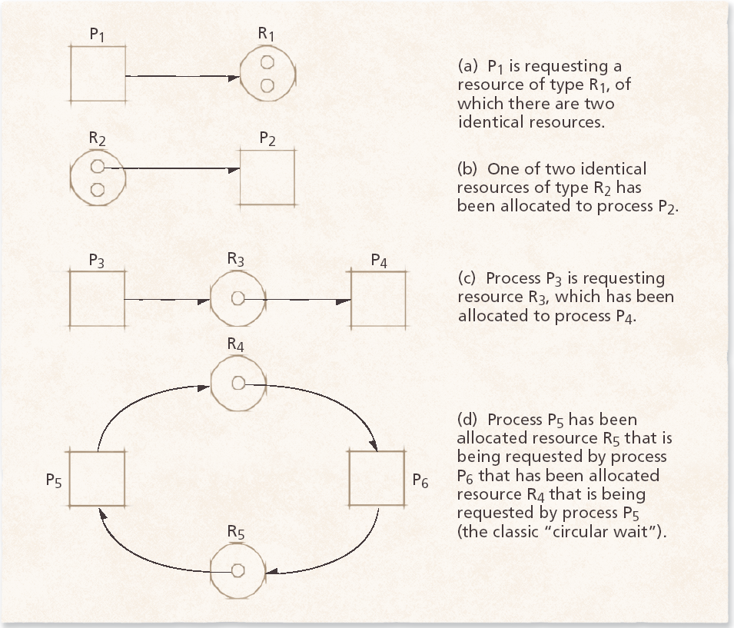
7.9.1 Resource-Allocation Graphs
Figure 7.10 Resource-allocation and request graphs.

Slide 25
Reduction of Resource-Allocation Graphs
Graph reductions
  If a process’s resource requests may be granted the graph may be reduced by that process
  If a graph can be reduced by all its processes, there is no deadlock
  If a graph cannot be reduced by all its processes, the irreducible processes constitute the set of deadlocked processes in the graph

Slide 26
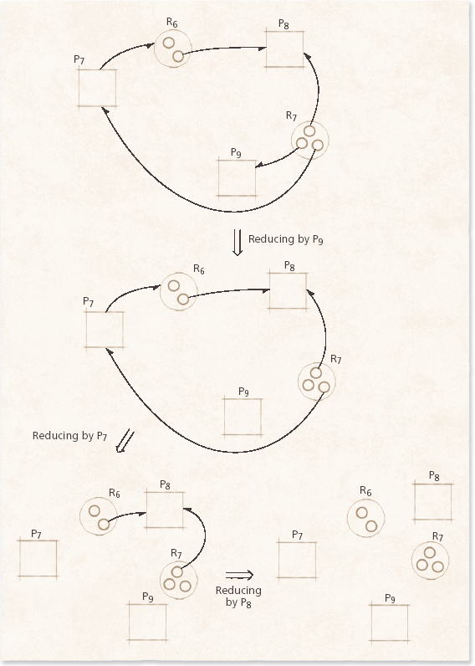
Reduction of Resource-Allocation Graphs
Graph reductions determining that no deadlock exists.

Slide 27
Deadlock Recovery
Deadlock recovery
  Clears deadlocks from system so that deadlocked processes may complete their execution and free their resources
Suspend/resume mechanism
  Allows system to put a temporary hold on a process
  Suspended processes can be resumed without loss of work
Checkpoint/rollback
  Facilitates suspend/resume capabilities
  Limits the loss of work to the time the last checkpoint was made

Slide 28
Deadlock Strategies in Current and Future Systems
Deadlock is viewed as limited annoyance in personal computer systems
  Some systems implement basic prevention methods suggested by Havender
  Some others ignore the problem, because checking deadlocks would reduce systems’ performance
Deadlock continues to be an important research area

